Slide 1


Machine Learning Hackathon
Team Name- DataWiz
Team Leader Name- Kaustav Das
Team Leader Email Address- daskaustav381@gmail.com

Slide 2
Brief Description of the Problem at hand:
The problem given is two folds, based on the dataset that is the ad server log.
Based on the user behavior recorded in the dataset classify whether the user is a health care professional or not (IS_HCP -> 0/1).
Based on the user behavior recorded try to predict the Taxonomy of the user. The 2nd problem statement was a more complex one and required a lot more data than was provided. Although task itself becomes fairly evident on further analysis of the problem. Taxonomy is provided through codes ,for example 2084P0800X, 207RG0100X which denotes the specialization that is the specific field of specialization to be exact. There is 207 unique taxonomy codes to classify from.

Slide 3
Solution proposed and description:
As with any data science problem majority of the solution finding is based on creating a good, and robust dataset with using as many features as possible while reducing variance and then training a ml model on it.
The challenge for this problem statement was to utilize all the significant categorical columns along with the textual data given in the dataset. To do so, what I have done is create a single data frame that contains both of the categorical and textual data available in a meaningfully low dimensional format. This, produced great result as it boosted the model performance score to 99.79 percent on the test data itself.

Slide 4
Approach:
I will be explaining my approach in a series of steps:
Feature Engineering:
Most of the feature engineering steps done is common and shared between both the tasks:
(a). Removal of stopwords from the KEYWORDS column and changing them into a lower-case format.
(b). Tokenizing the keywords and creating a corpus of words for further modelling purpose.
(c). The data was also checked for more erroneous constructs in the keyword column but none were found and after this step our vocabulary contained about 1500 unique words.
(d). To further increase our vocabulary of words we also used the url column from which we extracted the various WEBSITE names and used that as categorical feature. And the rest of the url was checked for more significant words in the url path and upon discovery of such words they were added bringing our total corpus to have about 8000 unique words.

Slide 5
Approach:
(e). Columns like DEVICETYPE, PLATFORMTYPE, and the WEBSITE names we derived in the previous steps were converted into categorical features with the help of Label Encoder and used in our dataset.
(f). Another column that we tried to use was the BIDREQUESTIP column for both the USERCITY column and the USERZIPCODE column had null data. So in this step we tried to use the ipdata api to fetch the cities for the given IPS which had missing cities.

Slide 6
Approach:
2. Eliminating imbalance:
For the binary classification problem of whether a person is a health care professional or not a class imbalance was seen. With 79,756 people belonging to non-HCP class and only 34,180 people belonging to HCP class, which could potentially create a bias problem for our machine learning models. To solve that SMOTE was used to oversample the minority HCP class to 79,756 rows and also increased the model performance.
Now for the taxonomy classification problem there were more than 144 classes out of 207 classes that had less than 10 samples some even having just one while the dominant classes ranged from 800 to 7000 samples per class, so yet again an oversampling strategy was used where any class that had less than a 100 samples were oversampled to have 100 samples using random over sampler.
An obvious observation made about the problem is that only HCP people have a taxonomy assigned to them but again even among them some didn’t have a taxonomy which gave rise to a new MISSING class.

Slide 7
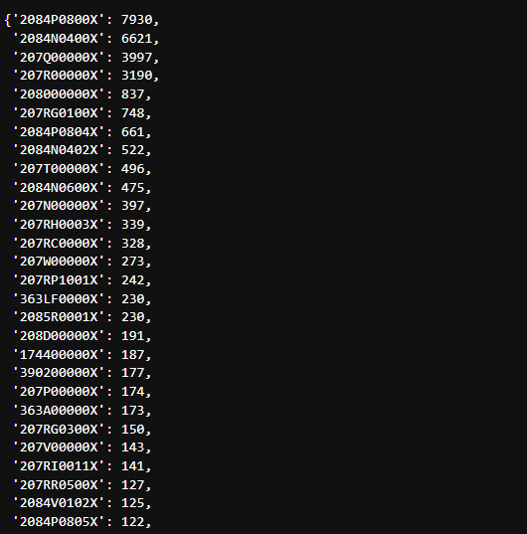
Approach:
2. Eliminating imbalance (class distribution):

Slide 8
Approach:
3. Modelling
(a). The first step to our modelling was to finalize our word embeddings, vectorization techniques such as tfidf were used but again produced high dimensionality and captured less contextual information, embeddings like fasttext, word2vec and bert embeddings were used and the most optimal result were given by ‘all-MiniLM-L6-v2’ model encodings from hugging face hub .
Base model (for which) can be found here : https://huggingface.co/nreimers/MiniLM-L6-H384-uncased

Slide 9
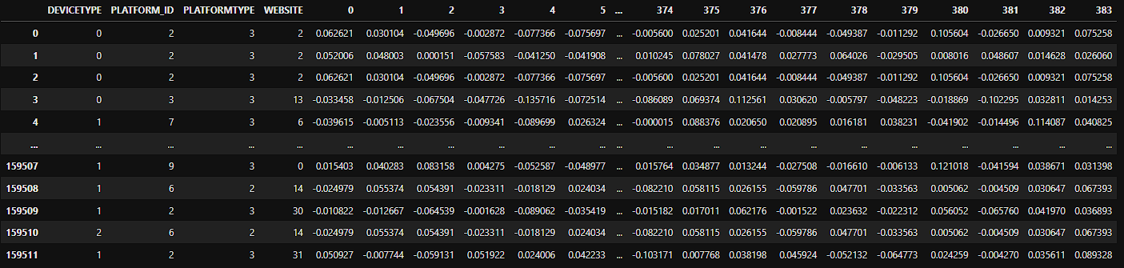
Approach:
3. Modelling
(b). Our final word embeddings were of size 384 dims and were concatenated with our 4 categorical features of PLATFORM_ID,DEVICETYPE,PLATFORMTYPE and WEBSITE. Our training data frame looked something like this with shape of (159512 x 388).
Categorical features
Textual features

Slide 10
Approach:
3. Modelling
(c). For modelling many models and ensemble of models were used and the best result submitted was given by base Random Forest i.e. 99.79% on test data.

Slide 11
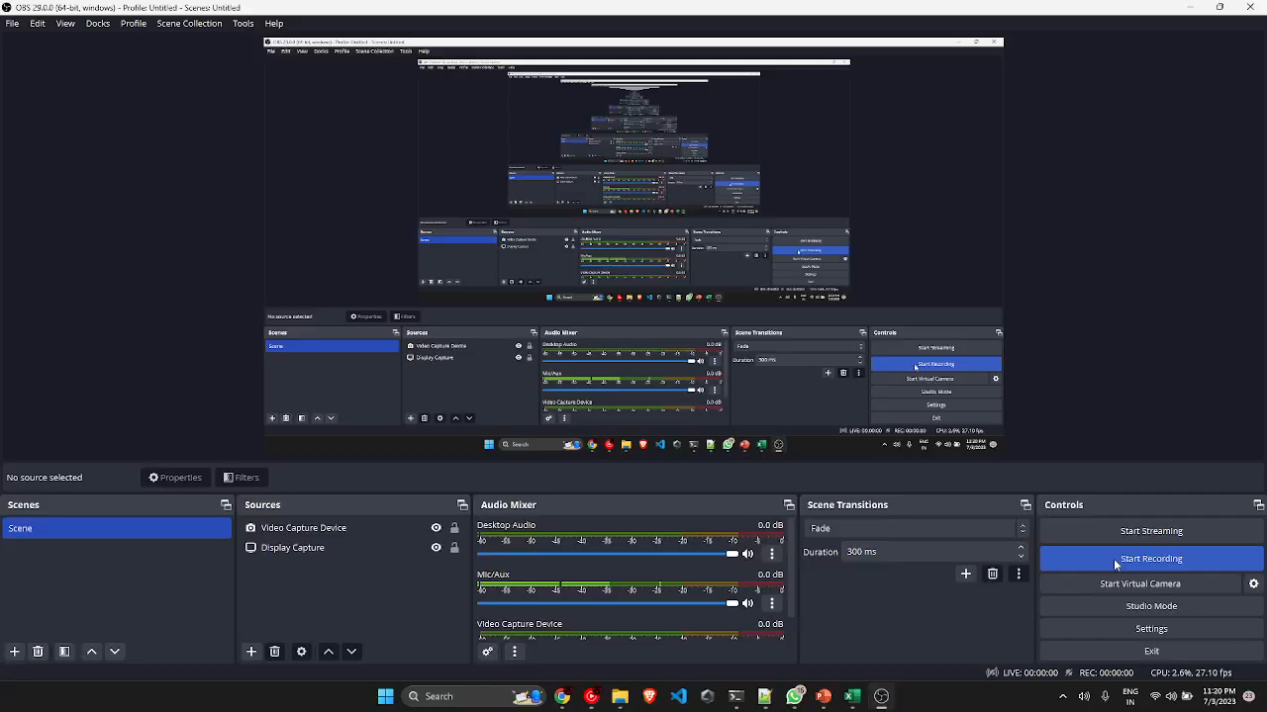
Execution Demo (Video/ Screenshots) of the solution:

Slide 12
Source code in ZIP file/Github URL:
All my code can be found here along with the resultant dataframe :
https://drive.google.com/drive/folders/1LY_Lmz68-MWE8yWp7Gf85gssXD0gLQ6r?usp=sharing

Slide 13
Additional comments (optional):
A deep learning approach that caters for both the categorical features and word embeddings will immediately produce better results on this.
About 60 percent of the models, performance is attributed to the heavy feature engineering as is evident that even a relatively simple ensemble model like random forest produces such accurate results.
My goal was to create a very efficient model without relying on the cutting-edge deep learning techniques and transformer architecture and that I think has been fulfilled. Model takes less than 10 mins to train and produces significantly good results as evident from the score obtained.

Slide 14
THANK YOU!

